Slide 1
Constructor

Slide 2
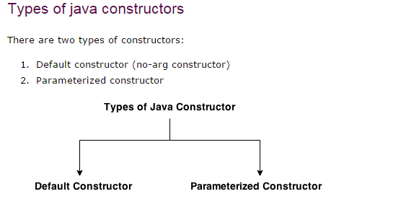
Definition -
Constructor is a special method that gets invoked automatically, at the time of object creation.
Constructor is normally used for initializing objects with default values, unless different values are supplied.
Constructor has the same name as the class name.
Constructor can not return values.
A class can have more than one constructor as long as they have different signature.

Slide 3
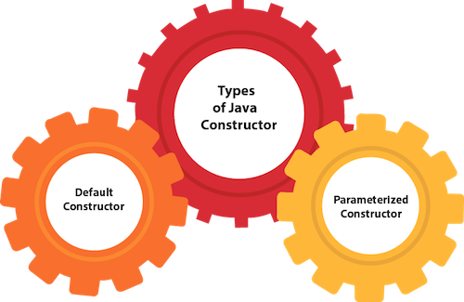
Rules for creating Java constructor -
There are two rules defined for the constructor.
Constructor name must be the same as its class name
A Constructor must have no explicit return type
A Java constructor cannot be abstract, static, final, and synchronized
Note: We can use access modifiers while declaring a constructor. It controls the object creation. In other words, we can have private, protected, public or default constructor in Java.

Slide 4
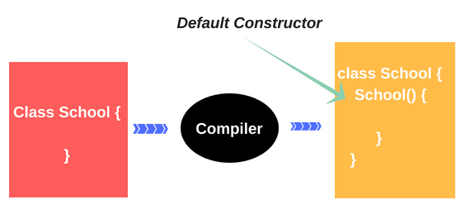
Default Constructor -
A default constructor is a constructor that either has no parameters, or if it has parameters, all the parameters have default values.
If there is no constructor in a class, compiler automatically creates a default constructor.

Slide 5
import java.util.*;
class DefaultConstructor
{
int x;
DefaultConstructor()
{
x = 999;
}
public static void main (String[] args)
{
DefaultConstructor DCobj = new DefaultConstructor();
System.out.println("Required Value is: " + DCobj.x);
}
}

Slide 6
Parameterized Constructor -
A constructor which has a specific number of parameters is called a parameterized constructor.
Why use the parameterized constructor?
The parameterized constructor is used to provide different values to distinct objects. However, we can provide the same values also.
Rule: If there is no constructor in a class, compiler automatically creates a default constructor.

Slide 7
import java.util.*;
class ParamConstructor
{
int x;
ParameterizedConstructor(int m)
{
x = m;
}
public static void main (String[] args)
{
ParamConstructor PCobj = new ParamConstructor(111);
System.out.println("Required Value is: " + PCobj.x);
}
}

Slide 8
Constructor Overloading -
In Java, a constructor is just like a method but without return type. It can also be overloaded like Java methods.
Constructor overloading in Java is a technique of having more than one constructor with different parameter lists. They are arranged in a way that each constructor performs a different task. They are differentiated by the compiler by the number of parameters in the list and their types.

Slide 9
import java.util.*;
class ConsOverloading
{
int a,b,sum;
static Scanner sc = new Scanner(System.in);
// Default Constructor
ConsOverloading()
{
a = 10;
b = 20;
sum = 0;
}
// Parameterized Constructor
ConsOverloading(int x, int y)
{
a = x;
b = y;
}

Slide 10
void addition()
{
sum = (a + b);
System.out.println("Required Sum is: " + sum);
}
public static void main (String[] args)
{
int p,q;
System.out.println("Enter the values: ");
p = sc.nextInt();
q = sc.nextInt();
// Default Constructor Calling
ConsOverloading CObj = new ConsOverloading();
CObj.addition();
// Parameterized Constructor Calling
ConsOverloading CObj1 = new ConsOverloading(p,q);
CObj1.addition();
}
}

Slide 11
Difference between constructor and method in Java -
Java Constructor | Java Method
A constructor is used to initialize the state of an object. | A method is used to expose the behavior of an object.
A constructor must not have a return type. | A method must have a return type.
The constructor is invoked implicitly. | The method is invoked explicitly.
The Java compiler provides a default constructor if we don't have any constructor in a class. | The method is not provided by the compiler in any case.
The constructor name must be same as the class name. | The method name may or may not be same as the class name.

Slide 12
Method Overloading in Java -
If a class has multiple methods having same name but different in parameters, it is known as Method Overloading.
If we have to perform only one operation, having same name of the methods increases the readability of the program.
Suppose we have to perform addition of the given numbers but there can be any number of arguments, if we write the method such as a(int,int) for two parameters, and b(int,int,int) for three parameters then it may be difficult for we as well as other programmers to understand the behavior of the method because its name differs.
So, we perform method overloading to figure out the program quickly.

Slide 13
Special Topics -
Advantages -
Method overloading increases the readability of the program.
There are two ways to overload the method in java -
By changing number of arguments
By changing the data type
NOTE: In java, Method Overloading is not possible by changing the return type of the method only

Slide 14
Method Overloading: Changing no. of arguments
class Adder
{
static int add(int a,int b)
{
return a+b;
}
static int add(int a,int b,int c)
{
return a+b+c;
}
}
class TestOverloading
{
public static void main(String[] args)
{
System.out.println( Adder.add(11,11));
System.out.println( Adder.add(11,11,11));
}
}

Slide 15
Method Overloading: Changing data type of arguments
class Adder
{
static int add(int a, int b)
{
return a+b;
}
static double add(double a, double b)
{
return a+b;
}
}
class TestOverloading
{
public static void main(String[] args)
{
System.out.println(Adder.add(11,11));
System.out.println(Adder.add(12.3,12.6));
}
}

Slide 16
Why Method Overloading is not possible by changing the return type of method only?
Special Questions -

Slide 17
Solution -
class Adder
{
static int add(int a,int b)
{
return a+b;
}
static double add(int a,int b)
{
return a+b;
}
}
class TestOverloading
{
public static void main(String[] args)
{
//ambiguity
System.out.println(Adder.add(11,11));
}
}

Slide 18
Note: Compile Time Error is better than Run Time Error. So, java compiler renders compiler time error if you declare the same method having same parameters.

